Slide 1
Simulation and Analysis of Mobile Ad Hoc Networks
Sai Abhishek Nemani
Manoj Panchakarla
Vamsi Kanuri
Notes:
abcd

Slide 2
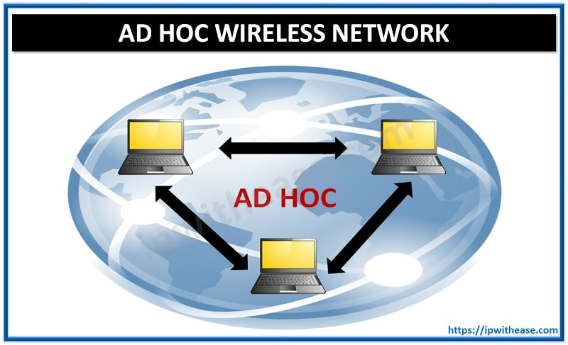
Introduction

Slide 3
Introduction to MANETs
  MANETs (Mobile Ad-Hoc Networks) are self-configuring networks of wireless devices that operate without centralized infrastructure. Imagine soldiers coordinating in hostile territory, drones mapping disaster zones, or emergency responders communicating after a hurricane—MANETs enable these critical operations.

Slide 4
Problem Statement
When we are dealing with the simulation we need to deal with unpredictable node movement, energy constraints, and constantly shifting topologies.
Traditional simulations are too complex (like NS-3).
My goal: Bridge the gap with an intuitive, visual simulator that leverages AI/ML to evaluate performance in real time.

Slide 5
Project Overview
System Architecture
Our platform offers:
  Real-Time Visualization of nodes, connections, and packet routing.
  Dynamic Protocol Analysis (AODV, DSDV, OLSR)
  AI-Powered Insights for anomaly detection and predictive routing.
  Energy Efficiency Tracking and scalability metrics.
  Scenario Testing (network partitioning, node clustering)
Notes:
abcd

Slide 6
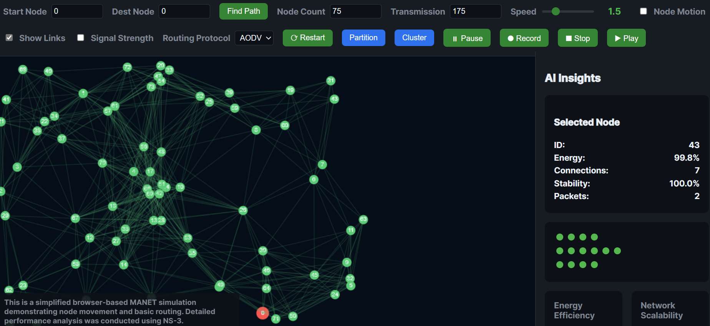
Technical Deep Dive And Implementation

Slide 7
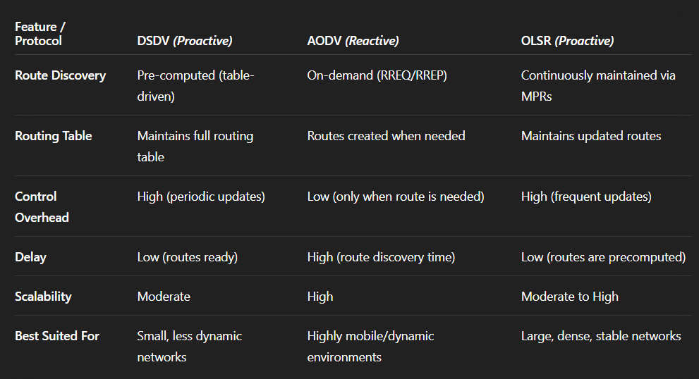
Protocols

Slide 8
Node Behavior
Each node:
  Moves randomly (toggleable)
  Consumes energy during transmission/movement
  Maintains neighbor lists based on signal strength
  Tracks packets handled (source, relay, destination roles)

Slide 9
AI Integration
Predictive Routing:
  Neural network forecasts optimal paths using node density, speed, and connectivity data.
Anomaly Detection:
  Autoencoder model flags unusual node behavior (e.g., sudden stops, erratic movement)

Slide 10
Use Cases & Applications
Disaster Response: Simulate drone networks for search-and-rescue
Military Operations: Test battlefield communication resilience IoT
Deployments: Optimize sensor networks in smart cities
Research & Education: Teach network concepts visually

Slide 11
Live Demo Walkthrough
Demo Interface
Adjust Parameters: Node count, speed, transmission range
Visualize Connections: Toggle link visibility and signal strength
Routing Protocols: Compare AODV (adaptive) vs. DSDV (table-driven)
AI Insights: Watch anomaly alerts and stability scores update
Scenario Testing: Create partitions or clusters to stress-test the network
Example: With 100 nodes at 2.5x speed, observe how OLSR handles rapid topology changes versus AODV.

Slide 12
Results & Findings
Performance Metrics
Routing Success Rate: AODV outperforms DSDV in high-mobility scenarios (92% vs. 78%)
Energy Efficiency: Predictive AI reduces consumption by 30%
Scalability: Network performance degrades gracefully up to 400 nodes.
Anomaly Detection: 89% accuracy in identifying faulty nodes.

Slide 13
Challenges & Solutions
Challenge: Balancing simulation accuracy with browser performance.
Solution: Optimized frame rendering and Web Workers for background AI tasks.
Challenge: Training lightweight ML models for real-time use.
Solution: Quantized TensorFlow.js models with minimal latency.

Slide 14
Future Enhancements
Roadmap
Add 5G/NR integration for modern MANETs
Implement 3D visualization for aerial networks
Expand AI to predict node failures
Develop collaborative analysis tools for multi-user scenarios

Slide 15
Conclusion
This platform bridges the gap between theoretical MANET research and practical deployment. By combining real-time visualization with AI-driven analytics, we empower network engineers to:
  Test configurations risk-free
  Optimize energy use
  Prepare for edge cases

Slide 16
Thankyou.

